Slide 1

BEHAVIOR OF SPORADIC E LAYERS DURING GEOMAGNETIC STORMS
(2014-2020)
Mariah L. O. Cesar, Marcio T. A. H. Muella, Paulo R. Fagundes
Instituto de Pesquisa e Desenvolvimento (IP&D) - UNIVAP
FAPESP 2024/07329-2

Slide 2

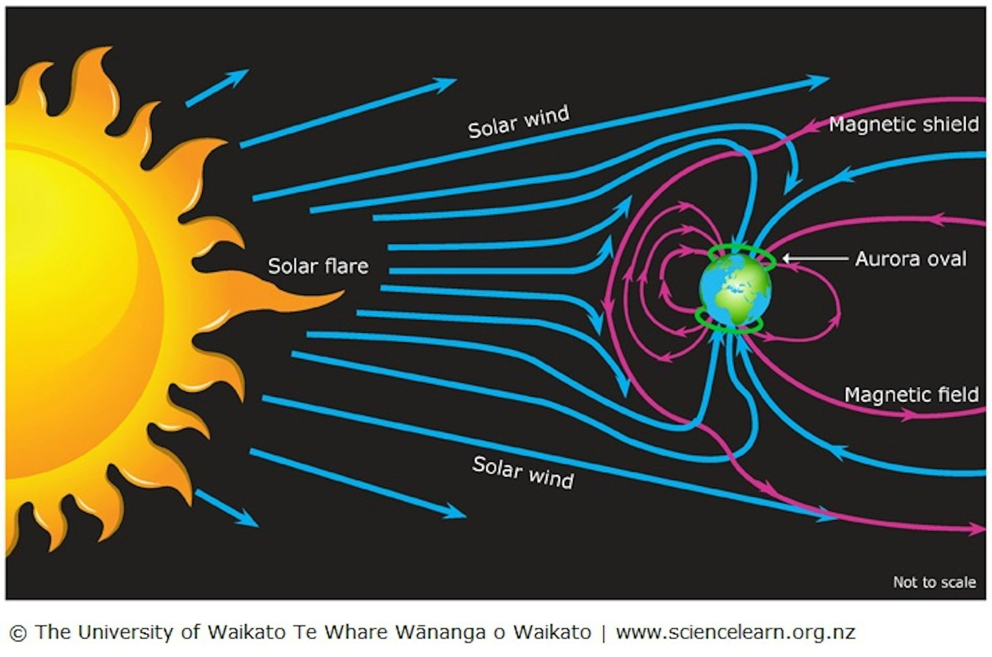
CONTEXT
Solar activity plays a fundamental role in the dynamics of Earth's near environment. Solar winds, charged with energetic particles, interact with ionospheric ions and electrons. These interactions can cause significant perturbations, such as geomagnetic storms, affecting global communication and navigation systems.

Slide 3
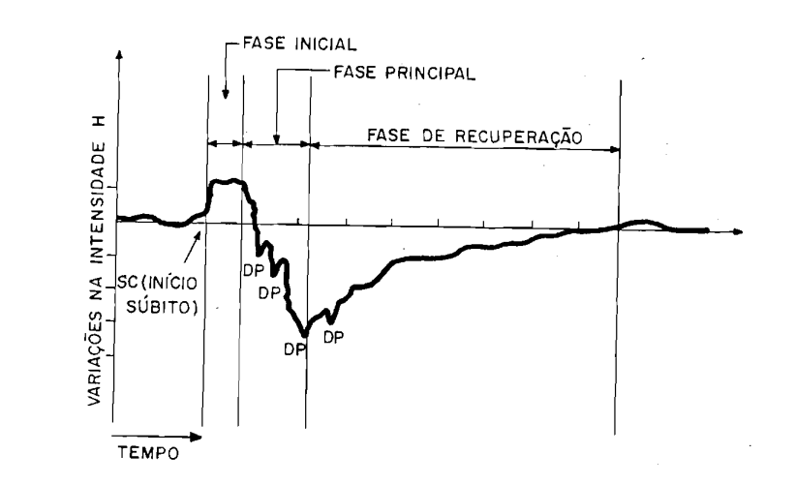
GEOMAGNETIC STORMS
Temporary perturbations in Earth's geomagnetic field caused by solar phenomena interacting with the terrestrial magnetosphere.
A geomagnetic storm is generally divided into three phases:
Initial Phase: Starts from the SSC (Sudden Storm Commencement), marked by a Dst index increase;
Main Phase: Sharp drop in Dst index due to ring current intensification;
Recovery Phase: Gradual return to pre-storm conditions (Dst reaches -30 nT).
De Paula (1987).

Slide 4
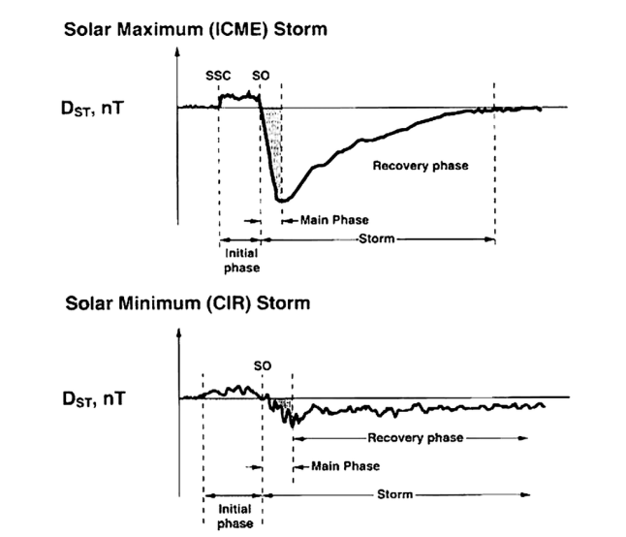
GEOMAGNETIC STORMS
Geomagnetic storms are classified according to the solar wind structure responsible for the event:
ICME (Interplanetary Coronal Mass Ejection): Mass ejections originating from the solar corona;
CIR (Corotating Interaction Region): Regions of interaction between high and low speed solar wind streams;
SIR (Stream Interaction Region): Interaction zones between plasma flows of different velocities.
Storms are identified and classified using geomagnetic indices: Dst, SYM-H, and Kp.
Tsurutani (2000).

Slide 5
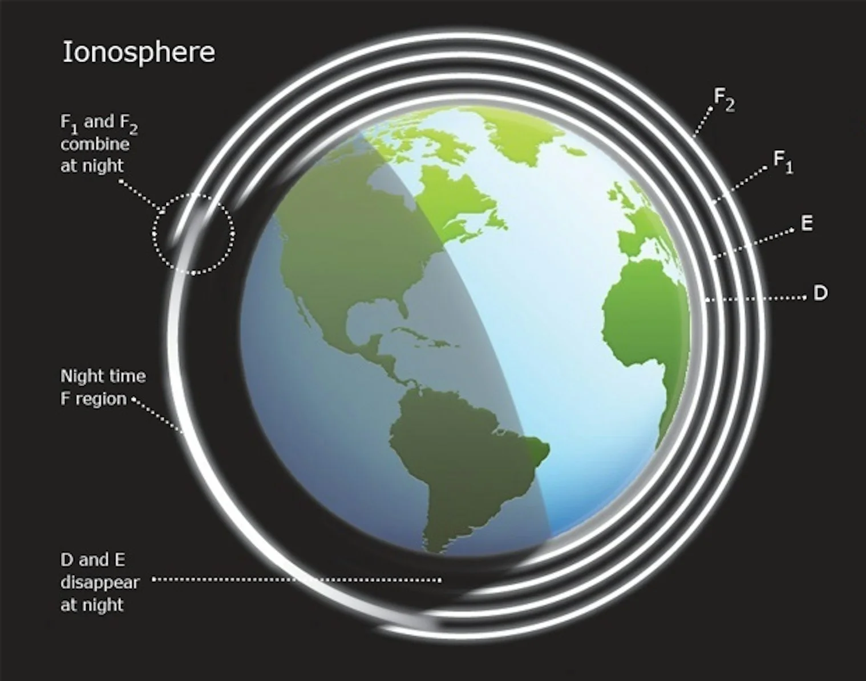
IONOSPHERE
Upper layer of the Earth's atmosphere (60 to 2000 km), characterized by ionized particles and free electrons, forming a conductive plasma medium.
Divided into three main regions:
D Layer (50-90 km): Low ionization, mainly diurnal;
E Layer (90-150 km): Intermediate ionization level;
F Layer (150+ km): Highest density (F1 and F2).
Geomagnetic storms alter plasma dynamics, directly affecting navigation and global communication systems.

Slide 6
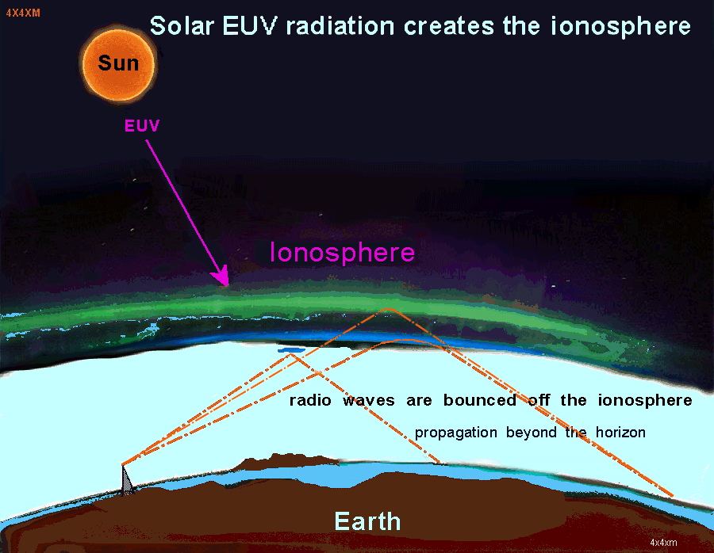
SPORADIC E (Es) LAYERS
Plasma enhancements within a narrow height range in the ionospheric E region, generally between 90 and 140 km altitude.
Formation is primarily associated with the neutral wind shear mechanism.
During geomagnetic disturbances, other factors contribute:
Penetration of disturbed electric fields;
Precipitation of energetic particles from the magnetosphere.

Slide 7
STUDY OBJECTIVES
Analyze the behavior of sporadic E layers during geomagnetic storms between 2014 and 2020, considering:
Storm Phase (Initial, Main, Recovery);
Solar Wind Structure (ICME, CIR, SIR);
Seasonality;
Event Intensity (Moderate to Super Intense);
Time of Day (Diurnal vs. Nocturnal);
Solar Flux (F10.7)

Slide 8
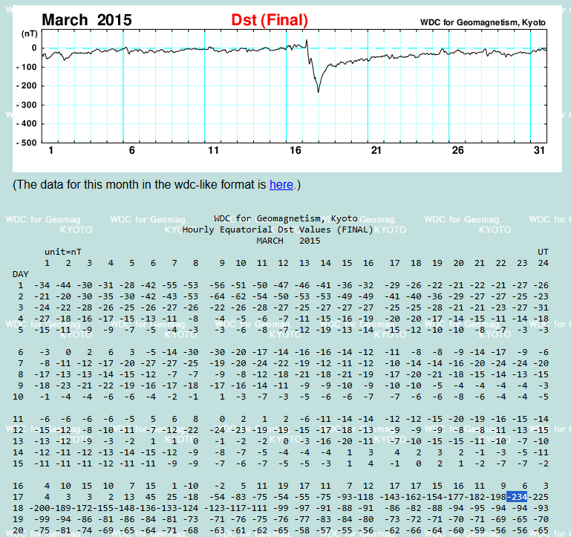
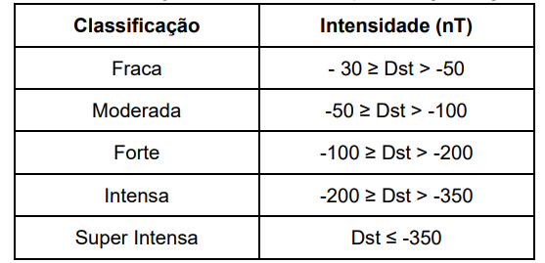
EVENT SELECTION
Events were selected from the Kyoto University World Data Center for Geomagnetism based on Dst and SYM-H indices.
The storms were identified by the SSC and classified into different intensity levels based on the minimum Dst value:
Fonte: Adaptada de Loewe e Prölss (1997).

Slide 9
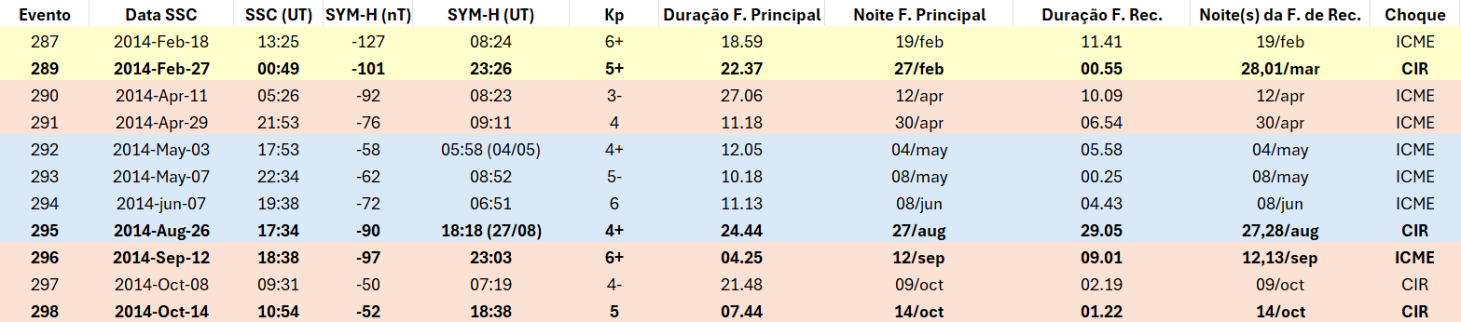
EVENT SELECTION
Each storm was organized by:
SSC date and time;
Minimum SYM-H value and time of occurrence;
Kp index;
Main phase duration and night(from SSC to minimum SYM-H);
Recovery phase duration and nights(from minimum SYM-H until returning to -30 nT);
Solar Wind Structure (ICME, CIR, or SIR);
A total of 78 events were identified, ranging from moderate to super-intense.

Slide 10
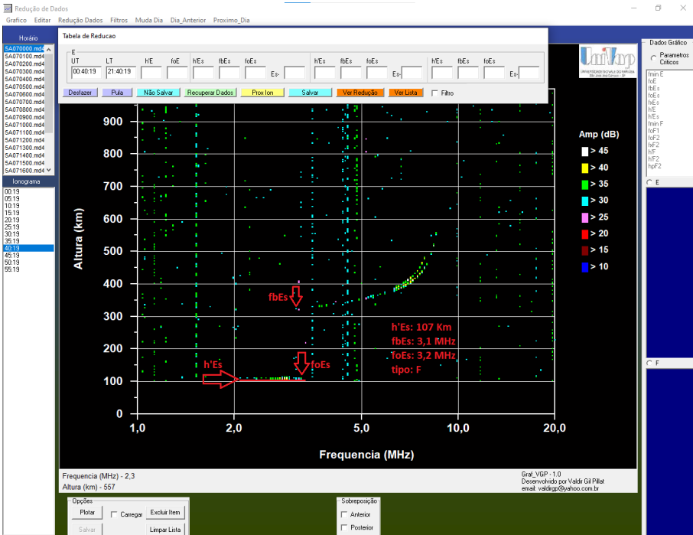
IONOGRAM DATA REDUCTION
Data reduction was performed using the UDIDA Software (Univap Digital Ionosonde Data Analysis).
Primary focus on recordings from the São José dos Campos digital ionosondes, but there were cases from Palmas digital ionosondes.
Extracted Parameters:
h’Es - Virtual Height;
fbEs - Blanketing Frequency;
ftEs - Top Frequency;
Type - flat, low, cusp, height, slant.
Each event were analyzed from the SSC to the end of the recovery phase.

Slide 11
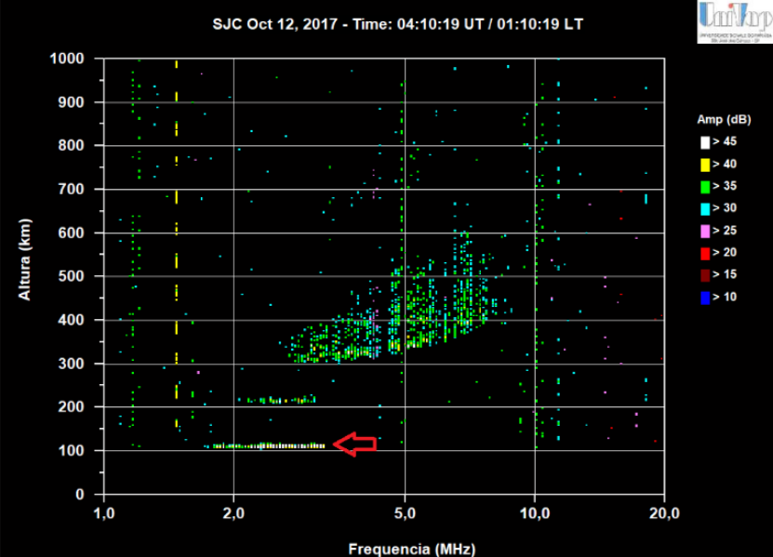
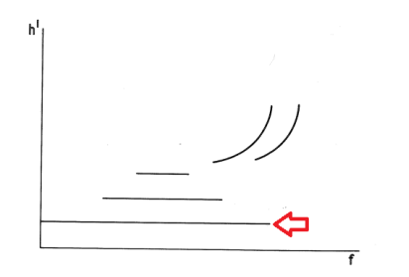
MORPHOLOGICAL ES TYPES
flat (Esf): characterized by a horizontal trace on the ionograms, in which the layer height remains constant with the increase of frequency. This type is frequently found in the nighttime period (18-6 LT).

Slide 12
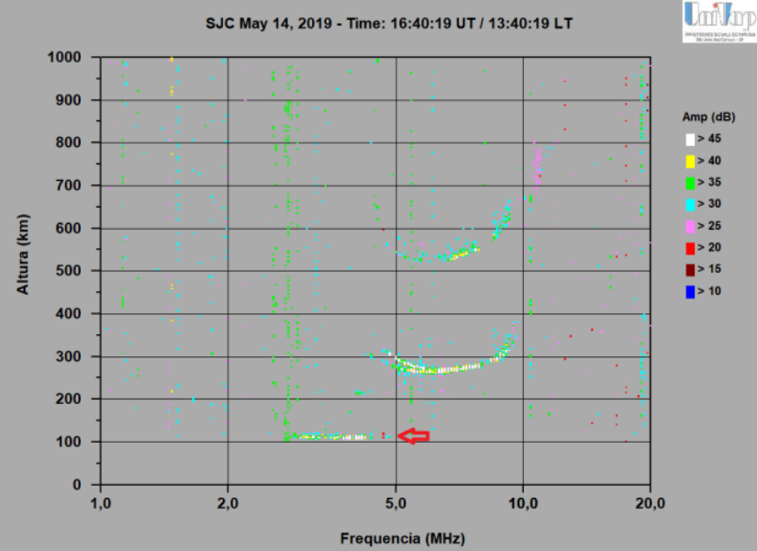
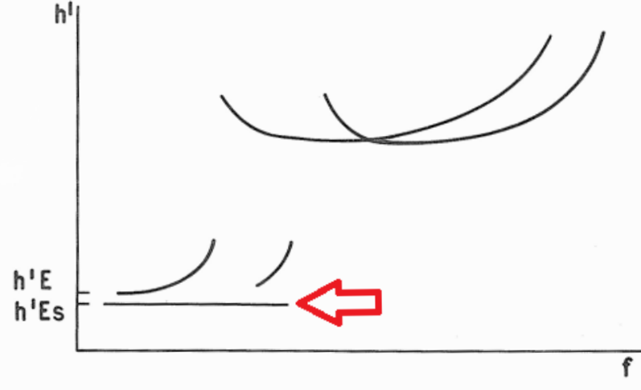
MORPHOLOGICAL ES TYPES
low (Esl): emerge at the minimum height of the E layer and remain at a constant height while the frequency increases. Their shape is similar to type f; the difference is given by the time at which they appear, as they are thus classified when observed during the day (6-18 LT).

Slide 13
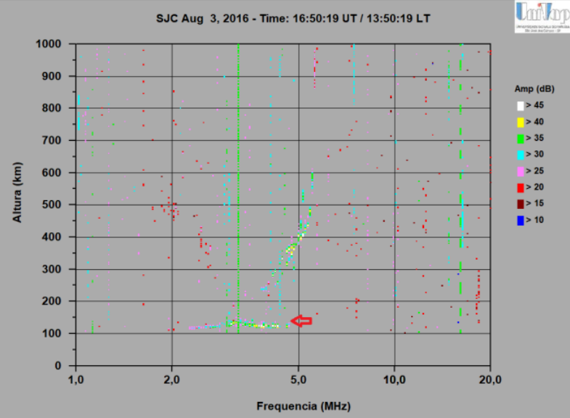
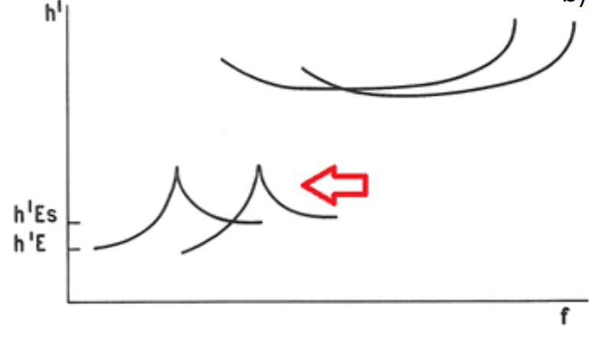
MORPHOLOGICAL ES TYPES
cusp (Esc): demonstrate a slight inclination and height variation, forming a characteristic cusp. In cases of strong absorption, this cusp may appear partially absent.

Slide 14
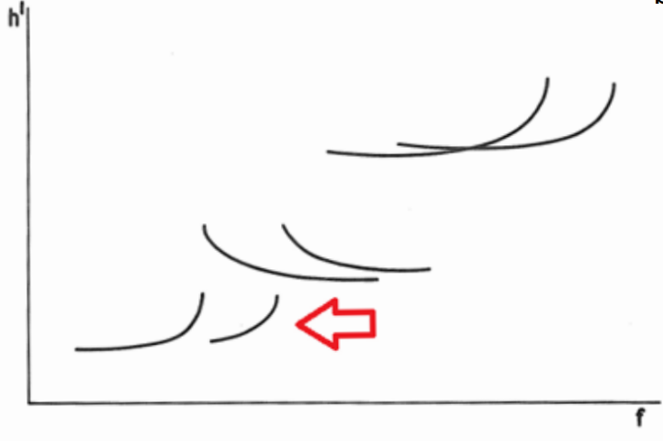
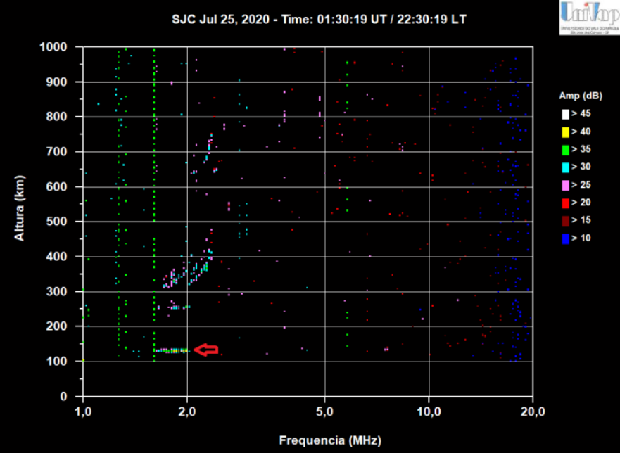

MORPHOLOGICAL ES TYPES
height (Esh): located at higher altitudes, generally between 120 and 140 km. These layers may present flat traces or asymmetrical cusps.

Slide 15
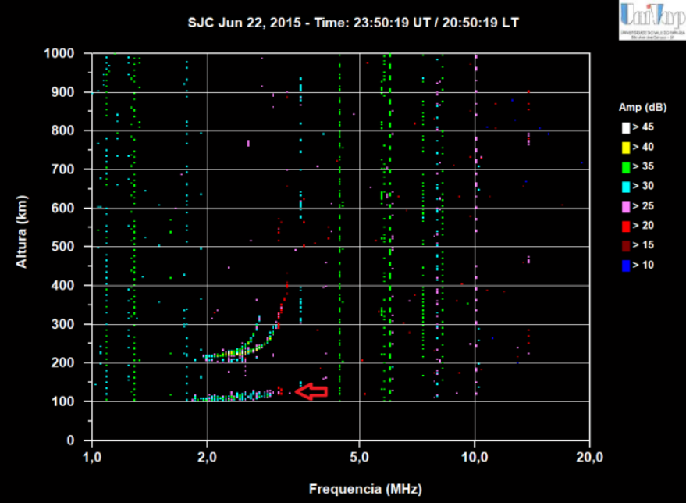
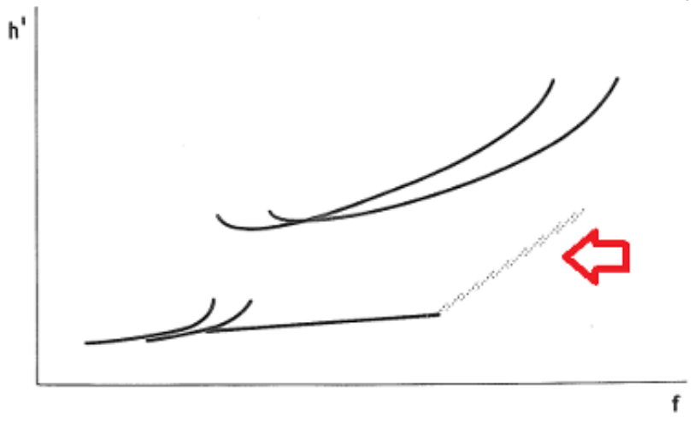
MORPHOLOGICAL ES TYPES
slant (Ess): present an inclined trace, in which the height increases constantly with frequency. This type generally arises from the evolution of other sporadic layers.

Slide 16
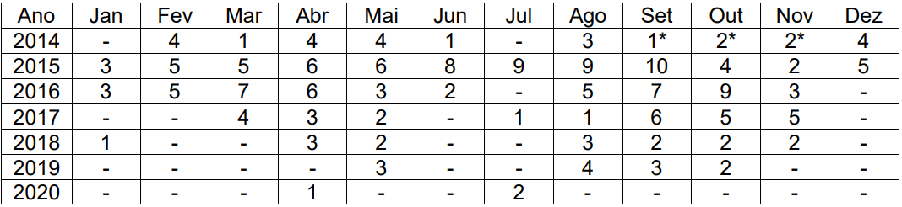
VOLUME OF DATA ANALYZED
78 events of moderate to super-intense intensity.
205 days of ionospheric data analyzed.
23,399 occurrences of sporadic E layers recorded.
The table shows the distribution of reduced days for each year.
Data organization and processing were performed using custom Python scripts, automating occurrence counting and rate calculations for each layer type under various conditions.

Slide 17

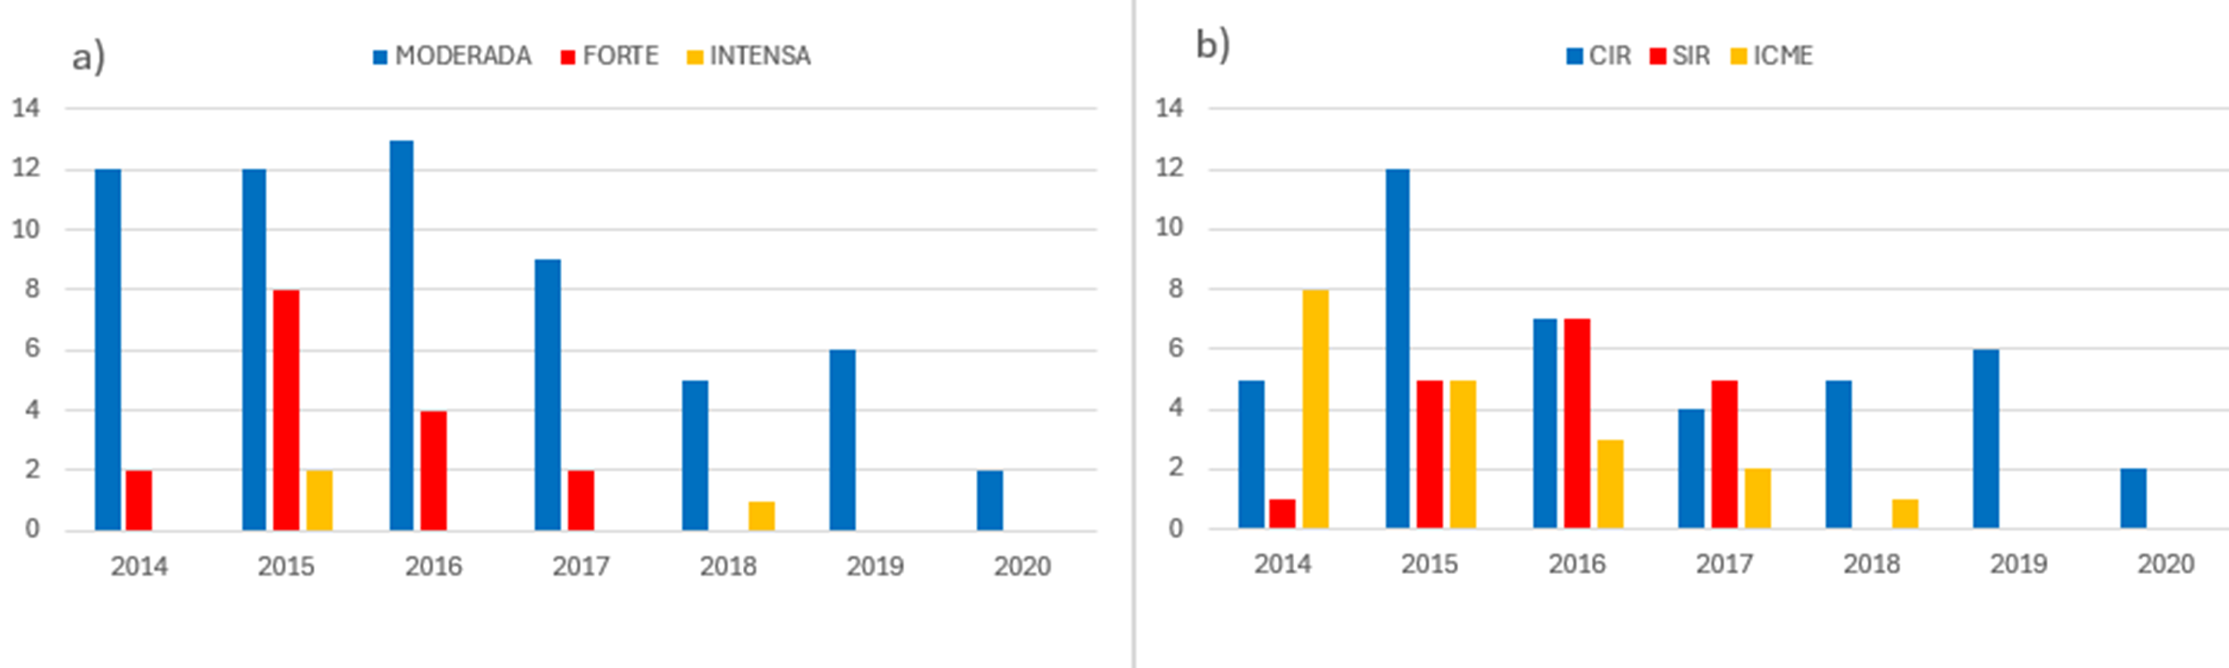

GEOMAGNETIC STORMS

Slide 18
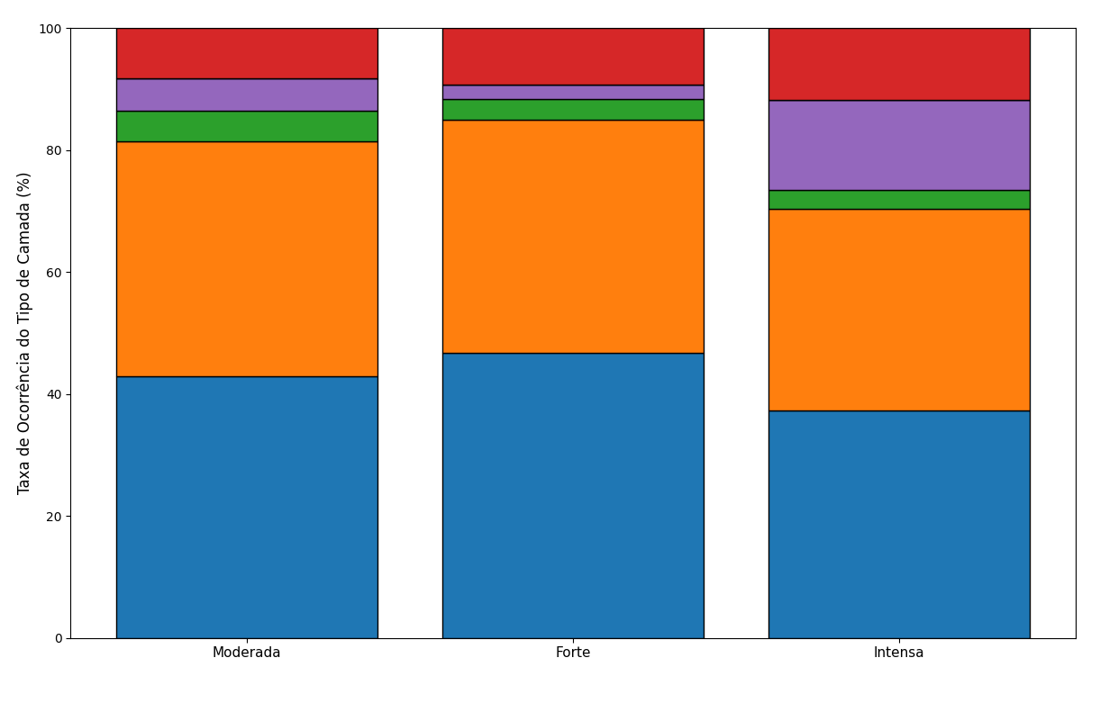
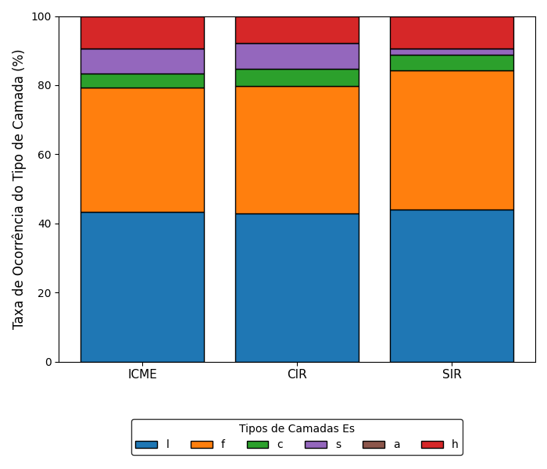
INTENSITY AND DRIVER

Slide 19
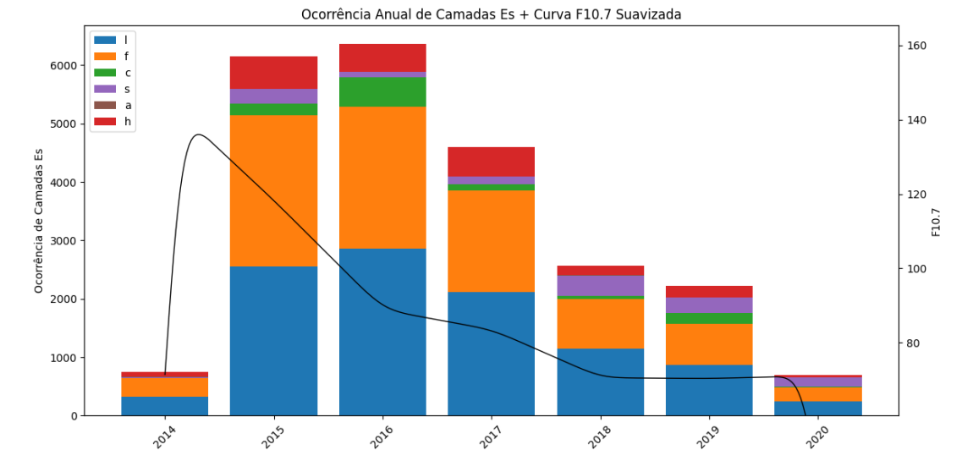
GENERAL TYPE DISTRIBUTION

Slide 20
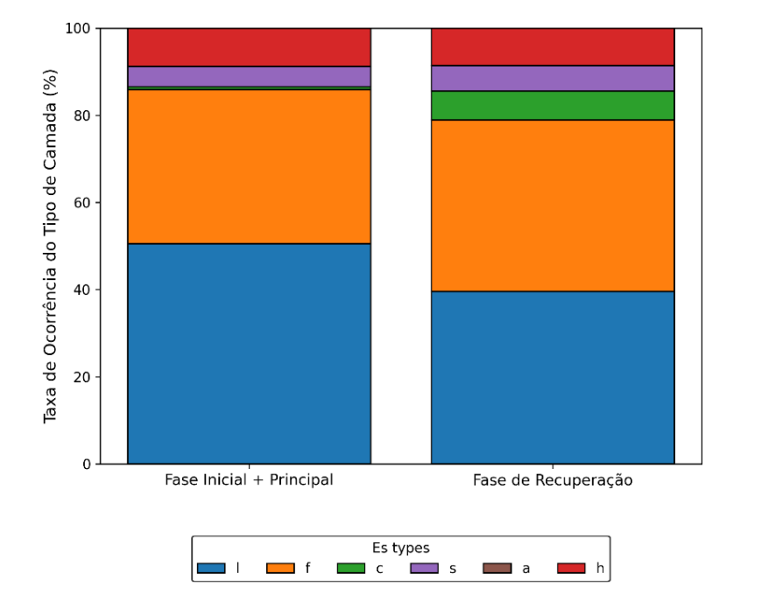
STORM PHASES

Slide 21
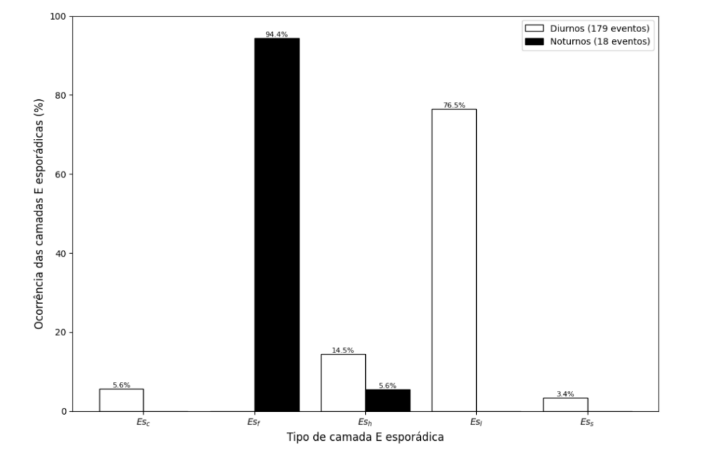
TIME OF THE DAY

Slide 22
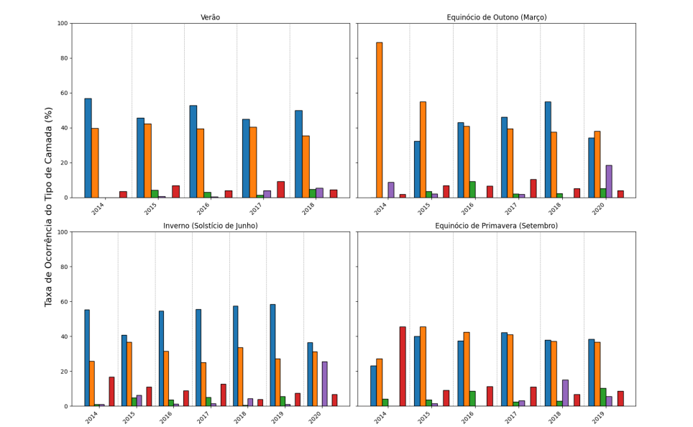

SEASONS

Slide 23
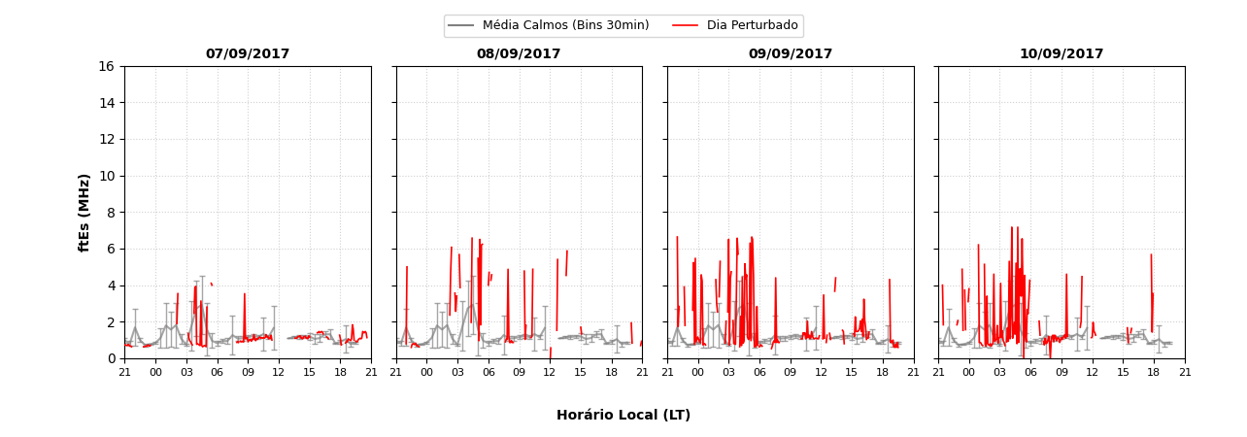
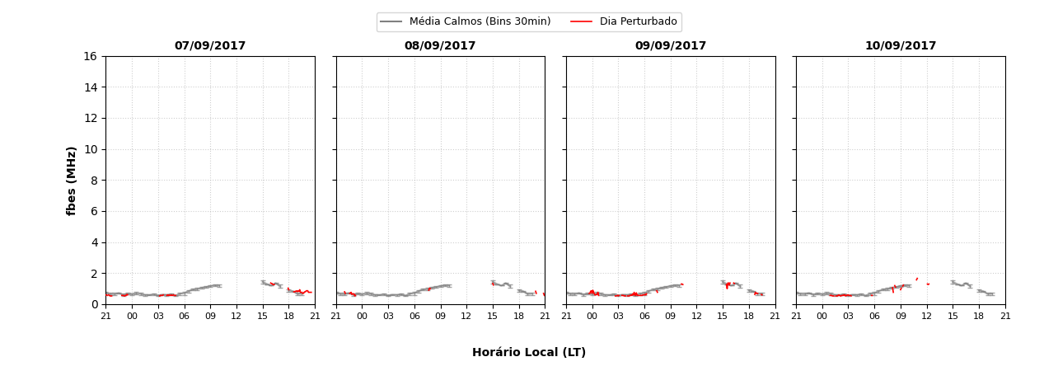
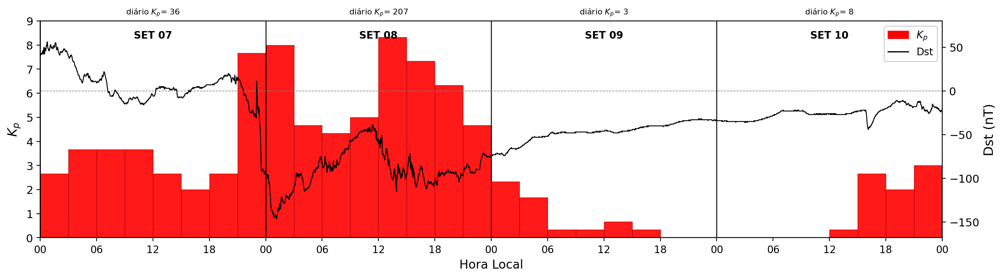
PRESENT STUDY
Strong ICME

Slide 24
CONCLUDING REMARKS
Complexity: Es layes behavior during disturbances is complex, non-linear, and driven by multiple geophysical factors;
Predominance: Flat (Esf) and low (Esl) morphological types dominate across all analyzed storm scnenarios and interplanetary drivers;
Recovery Phase: Exhibits the highest volume of occurrences and greatest morphological variability;
Diurnal Variation: Highest occurrence rate recorded during the day (Low type during daytime, Flat type at night);
Solar Influence: F10.7 solar flux directly correlates with annual occurrence, confirming solar activity as a key ionospheric driver;
Physical Mechanisms: Results reinforce that additional mechanisms operate during disturbed periods, extending beyond the classic neutral wind shear theory.

Slide 25
THANK YOU
To my advisors, Marcio Muella and Paulo R. Fagundes,
the professors at IP&D, my colleagues and to FAPESP (2024/07329-2).

Slide 26
